Slide 1
OS Lab - Python
Week 10

Slide 2
01
Socket Programming
Sockets using python.

Slide 3
Socket Programming
What is a Socket?
A socket is an endpoint of a communication between two programs running on a network. Sockets are used to create a connection between a client program and a server program.
What is Socket Programming
Socket programming is a way of connecting two nodes on a network to communicate with each other. One socket(node) listens on a particular port at an IP, while other socket reaches out to the other to form a connection. Server forms the listener socket while client reaches out to the server.

Slide 4
Socket Programming
Network Protocols
TCP/IP is a suite of protocols used by devices to communicate over the Internet and most local networks.
TCP is more reliable, has extensive error checking, and requires more resources. It is used by services such as HTTP, SMTP, or FTP.
The socket.SOCK_STREAM is used to create a socket for TCP.
UDP is much less reliable, has limited error checking, and requires less resources. It is used by services such as VoIP.
The socket.SOCK_DGRAM is used to create a socket for UDP.

Slide 5
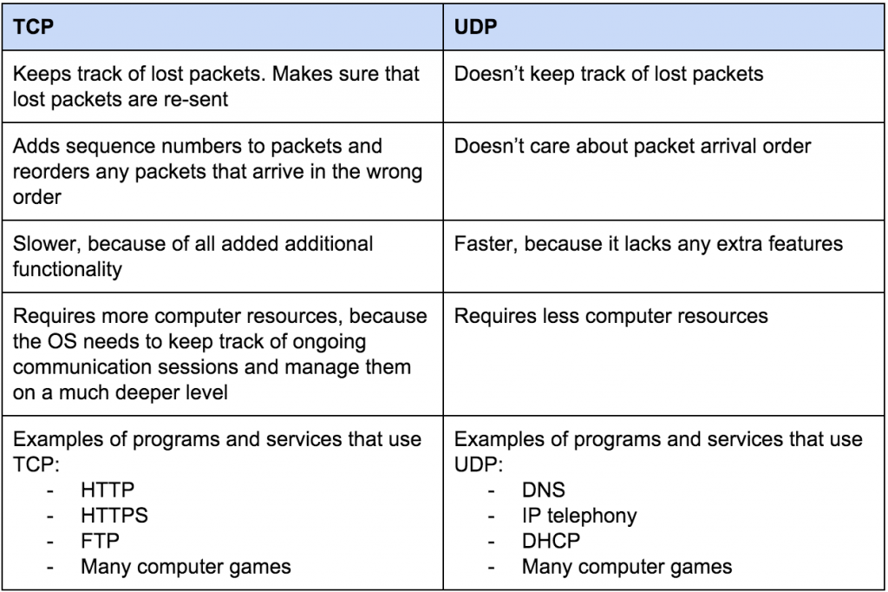
Socket Programming
TCP vs UDP

Slide 6
Socket Programming
Address Families
When we create a socket, we have to specify its address family. Then we can only use addresses of that type with the socket.
AF_UNIX, AF_LOCAL - Local communication
AF_INET - IPv4 Internet protocols
AF_INET6 - IPv6 Internet protocols
AF_IPX - IPX - Novell protocols
AF_BLUETOOTH - Wireless bluetooth protocols
AF_PACKET - Low level packet interface
For the AF_INET address family, a pair (host, port) is specified.
The host is a string representing either a hostname in Internet domain notation like example.com or an IPv4 address like 90.144.16.57, and port is an integer.

Slide 7
Socket Programming
The socket Module
To create a socket, you must use the socket.socket() function available in socket module, which has the general syntax:
s = socket.socket (socket_family, socket_type)
Example:
import socket s = socket.socket(socket.AF_INET, socket.SOCK_STREAM)
Here we made a socket instance and passed it two parameters. The first parameter is AF_INET and the second one is SOCK_STREAM. AF_INET refers to the address family ipv4. The SOCK_STREAM means connection oriented TCP protocol.
Once you have socket object, then you can use required functions to create your client or server program.

Slide 8
Socket Programming
Server Methods
Client Methods
Method | Description
s.bind() | This method binds address (hostname, port number pair) to socket.
s.listen() | This method sets up and start TCP listener.
s.accept() | This passively accept TCP client connection, waiting until connection arrives (blocking).
Method | Description
s.connect() | This method actively initiates TCP server connection.

Slide 9
Socket Programming
General Methods
Method | Description
s.recv() | This method receives TCP message.
s.send() | This method transmits TCP message.
s.recvfrom() | This method receives UDP message.
s.sendto() | This method transmits UDP message.
s.close() | This method closes socket.
s.gethostname() | Returns the hostname.

Slide 10
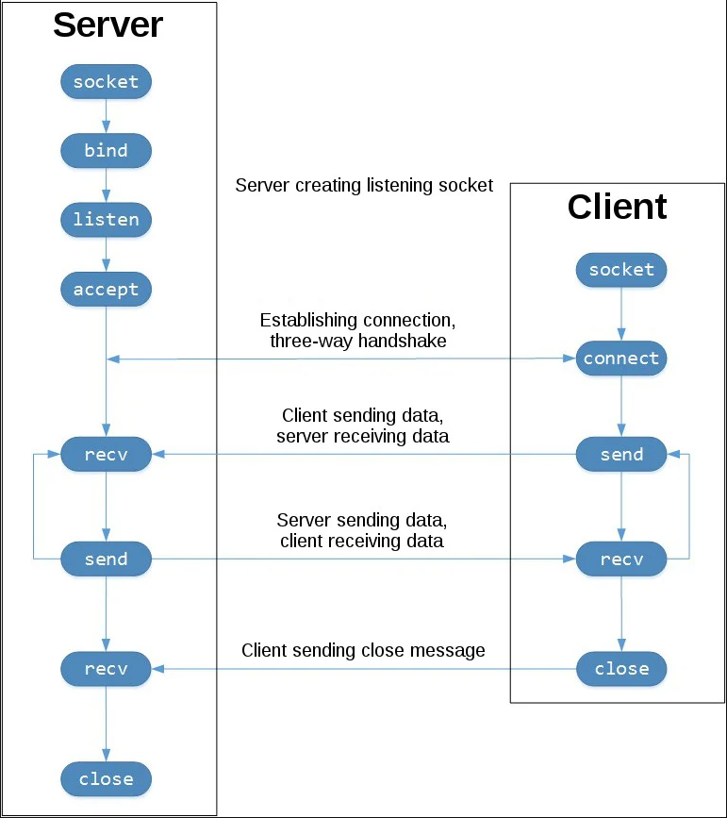
Server/Client TCP

Slide 11
Socket Programming
Socket Example (Server) / TCP
import socket
s = socket.socket(socket.AF_INET, socket.SOCK_STREAM) hostName = socket.gethostname() port = 1234 s.bind((hostName, port)) s.listen(5)
while True: clientsocket, address = s.accept() print("Connection from %s has been established." % (str(address))) serverMessage = “Thank you for connecting” clientsocket.send(serverMessage.encode(‘utf-8’)) clientsocket.close()

Slide 12
Socket Programming
Socket Example (Client) / TCP
import socket
s = socket.socket(socket.AF_INET, socket.SOCK_STREAM) hostName = socket.gethostname() port = 1234
s.connect((hostName, port)) msgFromServer = s.recv(1024) s.close() print (msgFromServer.decode('utf-8'))

Slide 13
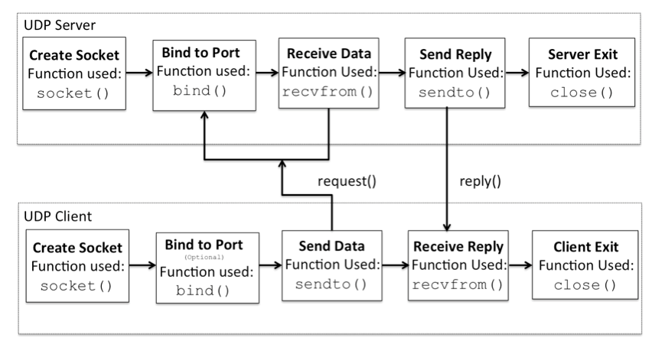
Server/Client UDP

Slide 14
Socket Programming
Socket Example (Server) / UDP
import socket
s = socket.socket(socket.AF_INET, socket.SOCK_DGRAM) s.bind(('127.0.0.1', 1234)) while True: print ("Waiting for client..") data, address = s.recvfrom(1024) print ("Received Messages: %s from %s" % (str(data.decode('utf-8')), str(address)))

Slide 15
Socket Programming
Socket Example (Client) / UDP
import socket
s = socket.socket(socket.AF_INET, socket.SOCK_DGRAM) Address = (‘127.0.0.1’, 1234) msg = 'Hello There' s.sendto(msg.encode('utf-8'), Address)

Slide 16
Example#1 of sending file from server to the client (TCP)
Server side
import socket
s = socket.socket(socket.AF_INET, socket.SOCK_STREAM)
hostName = socket.gethostname() #server host name
port = 1234 #server port
s.bind((hostName, port))
s.listen(5)
while True:
clientsocket, address = s.accept()
print("Connection from %s has been established." % (str(address)))
with open('file1.txt','r') as file:
content = file.read()
clientsocket.send(content.encode('ascii'))
msg = 'Done!'
clientsocket.send(msg.encode('ascii'))
clientsocket.close()

Slide 17
Example#1 of sending file from server to the client (TCP)
Client side
import socket
s = socket.socket(socket.AF_INET, socket.SOCK_STREAM)
hostName = socket.gethostname() #server host name
port = 1234 #server port
s.connect((hostName, port))
with open('file2.txt','w') as file:
contentFromServer = s.recv(1024) # buffer size
file.write(contentFromServer.decode('ascii'))
msgFromServer = s.recv(1024)
print(msgFromServer.decode('ascii'))
s.close()

Slide 18
Example#2 of sending file from server to the client (TCP)
Server side
import socket
s = socket.socket(socket.AF_INET, socket.SOCK_STREAM)
hostName = socket.gethostname() #server host name
port = 1234 #server port
s.bind((hostName, port))
s.listen(5)
buffer_size = 10
while True:
clientsocket, address = s.accept()
print("Connection from %s has been established." % (str(address)))
with open('file1.txt','r') as file:
content = file.read(buffer_size)
while content:
clientsocket.send(content.encode('ascii'))
content = file.read(buffer_size)
clientsocket.close()

Slide 19
Example#2 of sending file from server to the client (TCP)
Client side
import socket
s = socket.socket(socket.AF_INET, socket.SOCK_STREAM)
hostName = socket.gethostname() #server host name
port = 1234 #server port
s.connect((hostName, port))
while True:
contentFromServer = s.recv(10)
if len(contentFromServer) > 0:
with open('file2.txt','a') as file:
file.write(contentFromServer.decode('ascii'))
else:
break
s.close()

Slide 20
Example#1 of sending file from server to the client (UDP)
Server side
import socket
s = socket.socket(socket.AF_INET, socket.SOCK_DGRAM)
s.bind(('127.0.0.1', 1234))
buffer_size = 1024
while True:
print ("Waiting for client..")
data, address = s.recvfrom(buffer_size) # it is the buffer size
print ("Received Messages: %s from %s" % (str(data.decode('utf-8')), str(address)))
with open('file1.txt','r') as file:
content = file.read()
s.sendto(content.encode('ascii'),address)
m = 'Done!'
s.sendto(m.encode('ascii'), address)

Slide 21
Example#1 of sending file from server to the client (UDP)
Client side
import socket
s = socket.socket(socket.AF_INET, socket.SOCK_DGRAM)
Address = ('127.0.0.1', 1234)
buffer_size = 1024
msg = 'Hello There'
s.sendto(msg.encode('utf-8'), Address)
data, add = s.recvfrom(buffer_size)
with open('file2.txt','w') as file:
file.write(data.decode('ascii'))
msg, add = s.recvfrom(buffer_size)
print(msg.decode('ascii'))

Slide 22
Example#2 of sending file from server to the client (UDP)
Server side
import socket
s = socket.socket(socket.AF_INET, socket.SOCK_DGRAM)
s.bind(('127.0.0.1', 1234))
buffer_size = 10
while True:
print ("Waiting for client..")
data, address = s.recvfrom(buffer_size) # it is the buffer size
print ("Received Messages: %s from %s" % (str(data.decode('utf-8')), str(address)))
with open('file1.txt','r') as file:
content = file.read(buffer_size)
while content:
s.sendto(content.encode('ascii'),address)
content = file.read(buffer_size)

Slide 23
Example#2 of sending file from server to the client (UDP)
Client side
import socket
s = socket.socket(socket.AF_INET, socket.SOCK_DGRAM)
Address = ('127.0.0.1', 1234)
buffer_size = 10
msg = 'Hello There'
s.sendto(msg.encode('utf-8'), Address)
data, add = s.recvfrom(buffer_size)
with open('file2.txt','w') as file:
try:
while data:
file.write(data.decode('ascii'))
s.settimeout(2)
data, add = s.recvfrom(buffer_size)
except:
print('Download completed')

